Slide 1
Όταν τα παραμύθια των αδελφών Grimm επιστρέφουν στους ενηλίκους η περίπτωση των κόμικς
Μαριάννα Μίσιου (Διδάκτωρ Πανεπιστημίου Αιγαίου)
Γιάννης Κουκουλάς (Υπ. Διδάκτωρ ΑΣΚΤ)

Slide 2
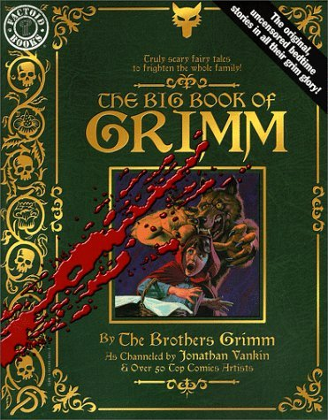
The Big Book of Grimm Jonathan Vankin 1990

Slide 3
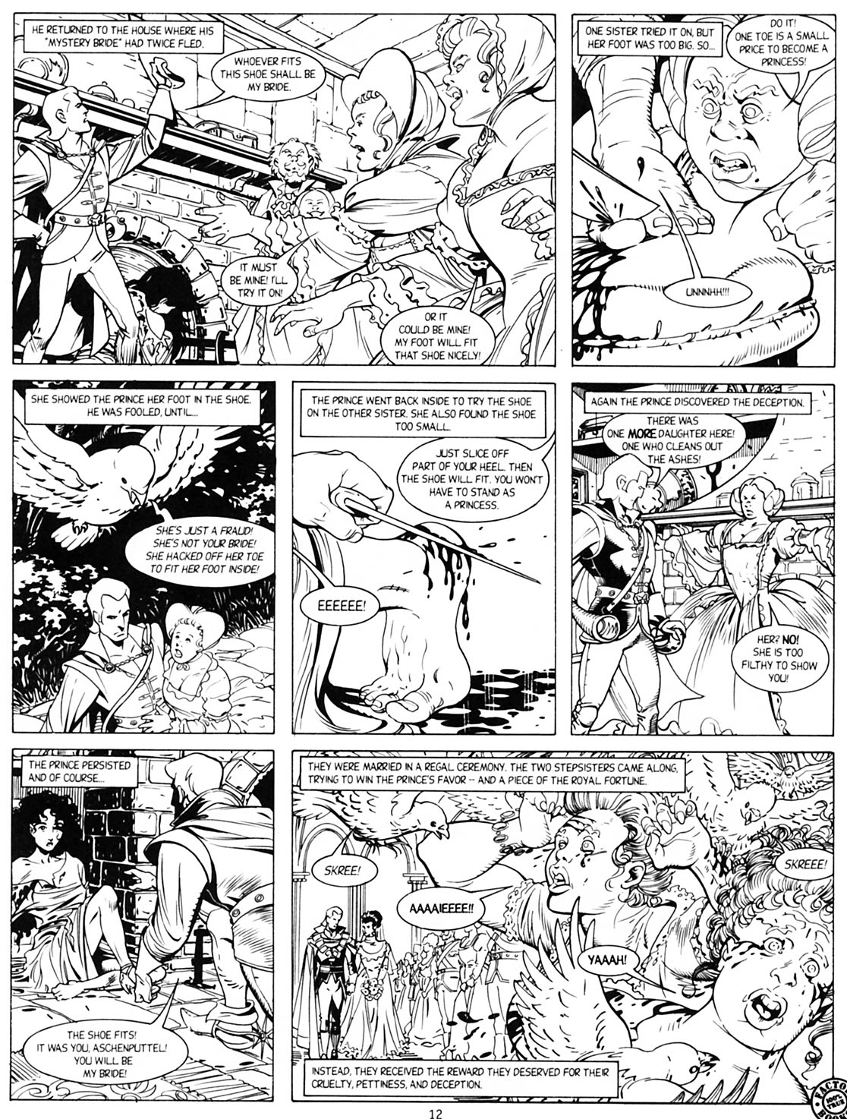
Aschenputtel or Cinderella
Jonathan Vankin – George Freeman
1990

Slide 4
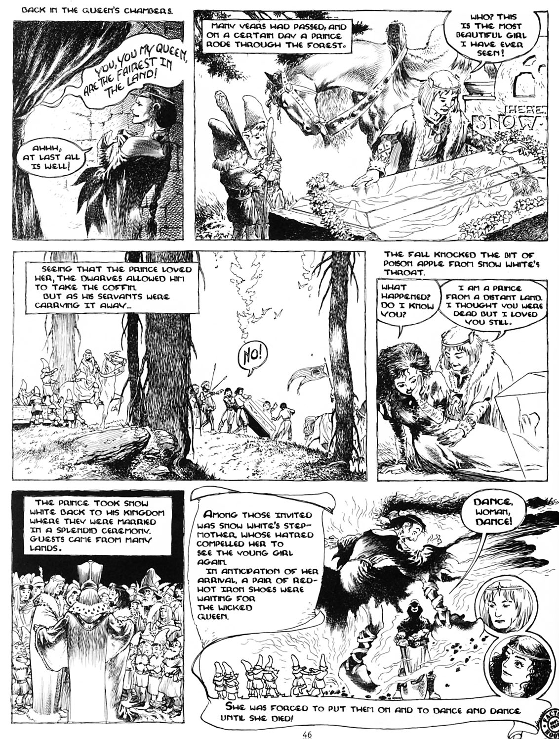
Snow White
Jonathan Vankin – Charles Vess
1990

Slide 5
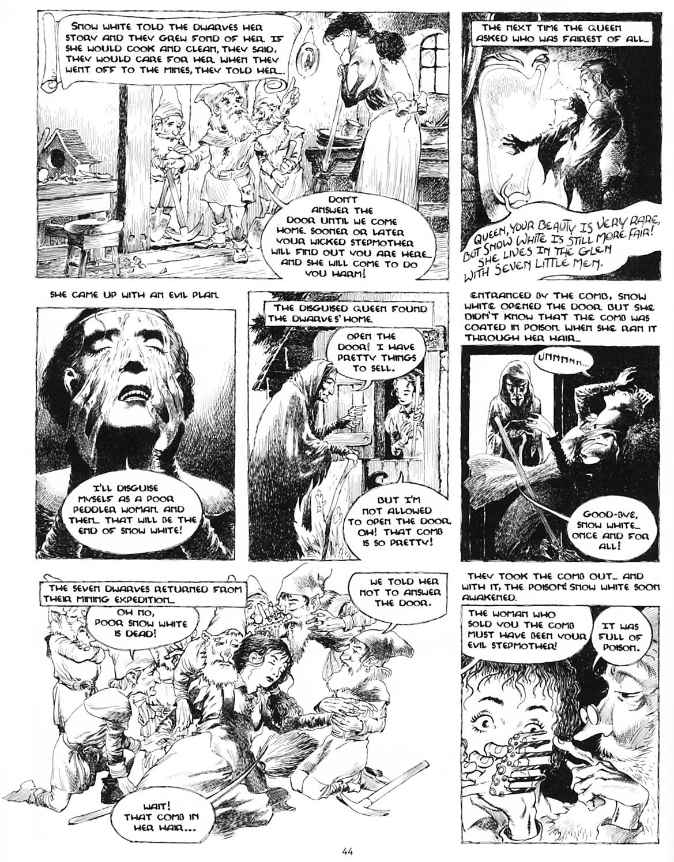
Snow White
Jonathan Vankin – Charles Vess
1990

Slide 6
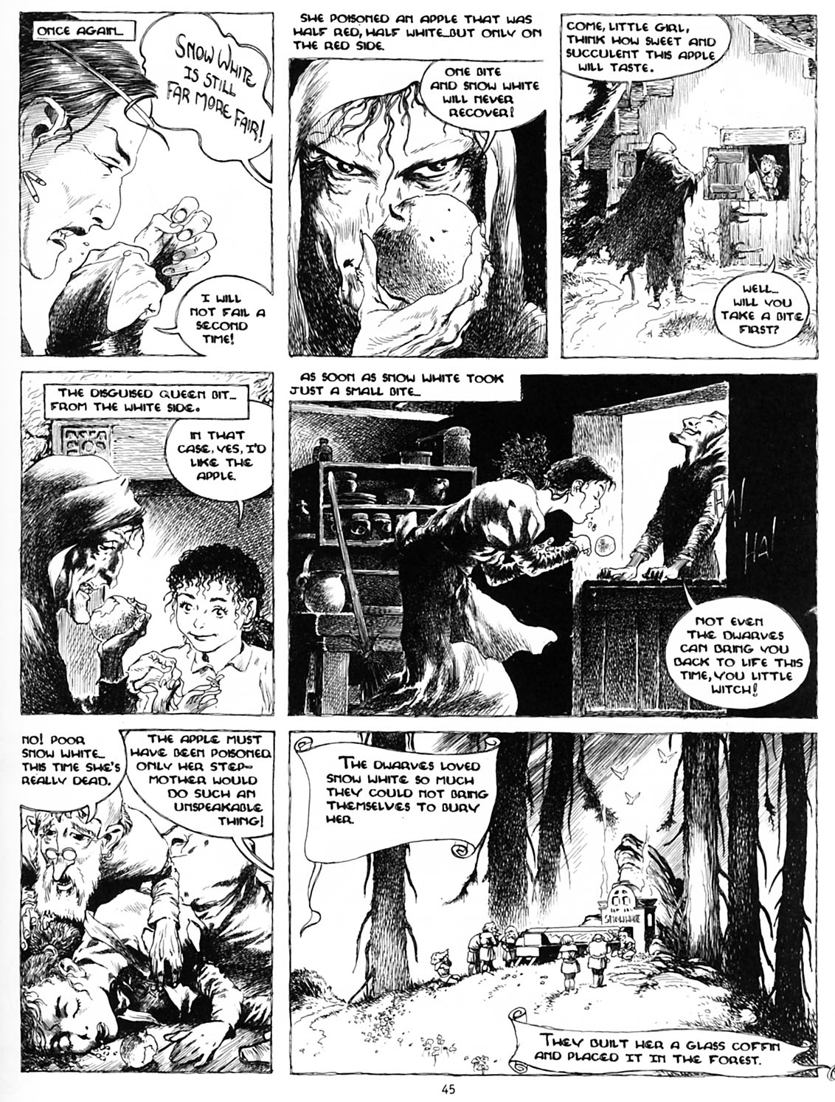
Snow White
Jonathan Vankin – Charles Vess
1990

Slide 7
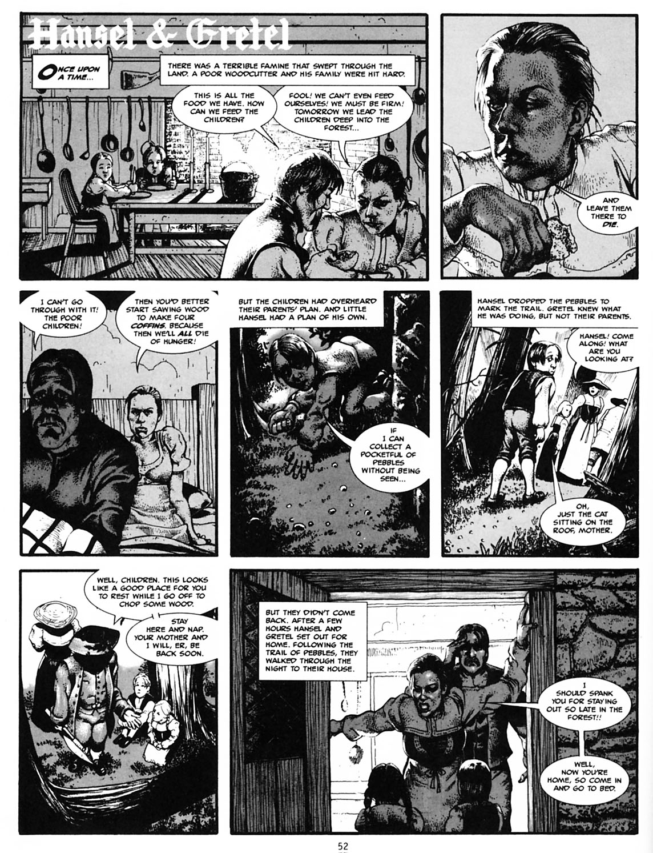
Hansel & Gretel
Jonathan Vankin – John Cebollero
1990

Slide 8
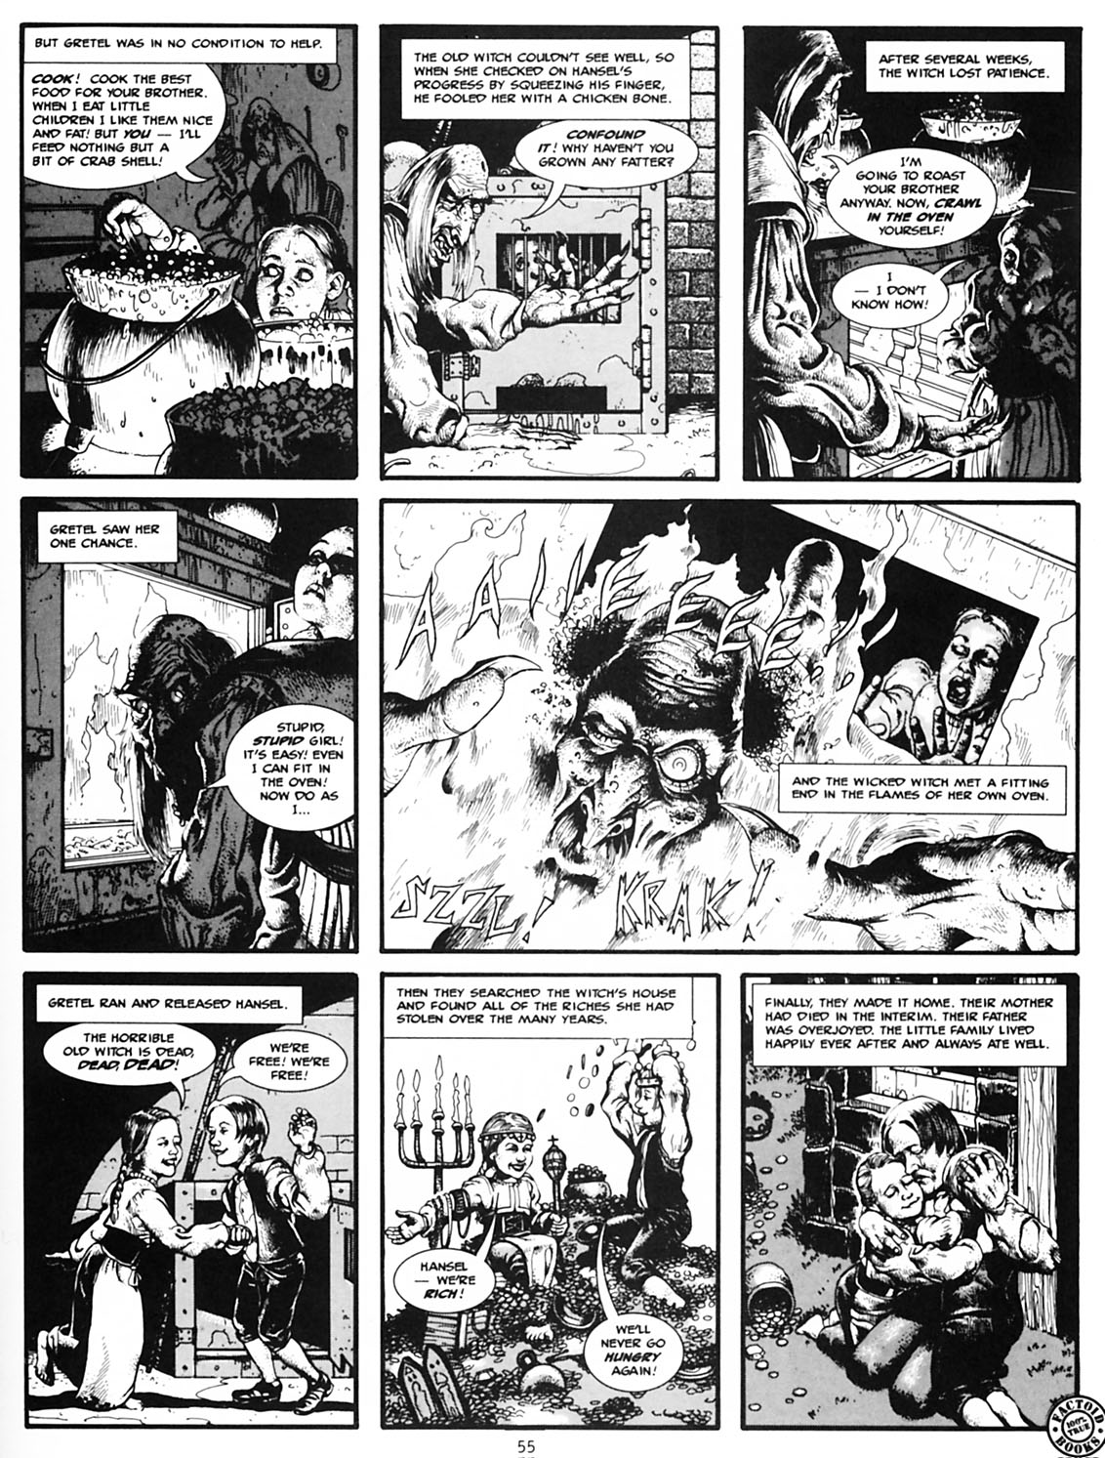
Hansel & Gretel
Jonathan Vankin – John Cebollero
1990

Slide 9
Cinderalla
Junko Mizuno
2002

Slide 10
Cinderalla
Junko Mizuno
2002

Slide 11
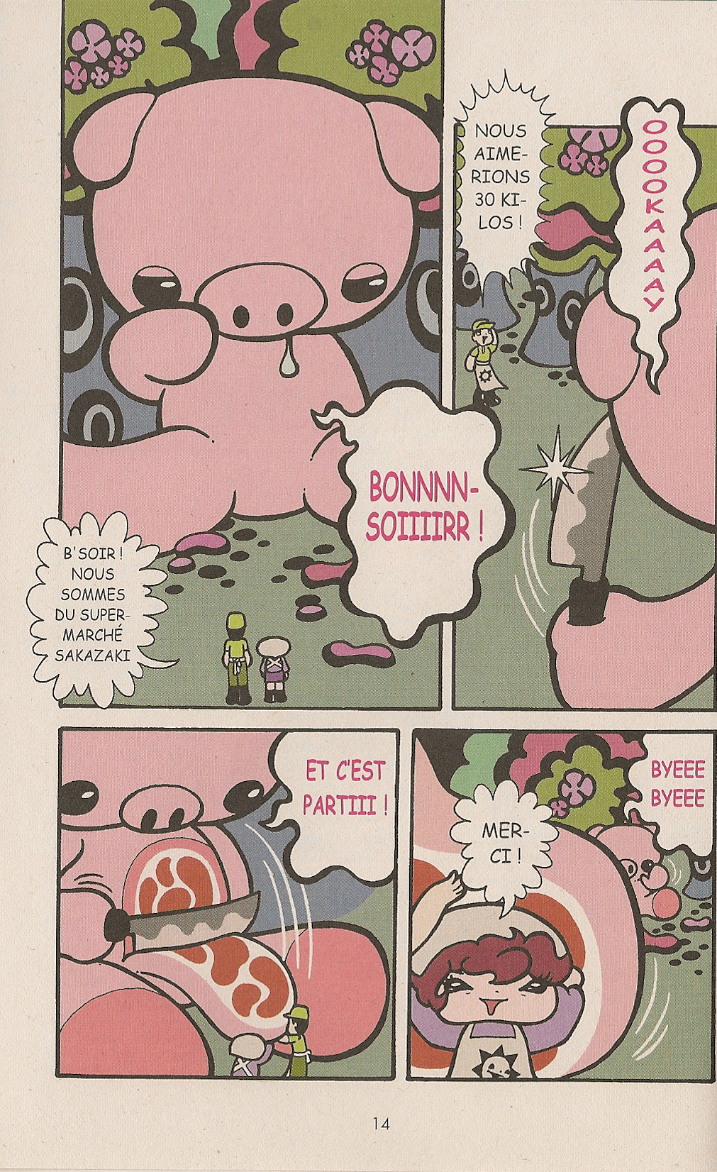
Hansel & Gretel
Junko Mizuno
2003

Slide 12
The Big Book of Grimm Jonathan Vankin 1990

Slide 13
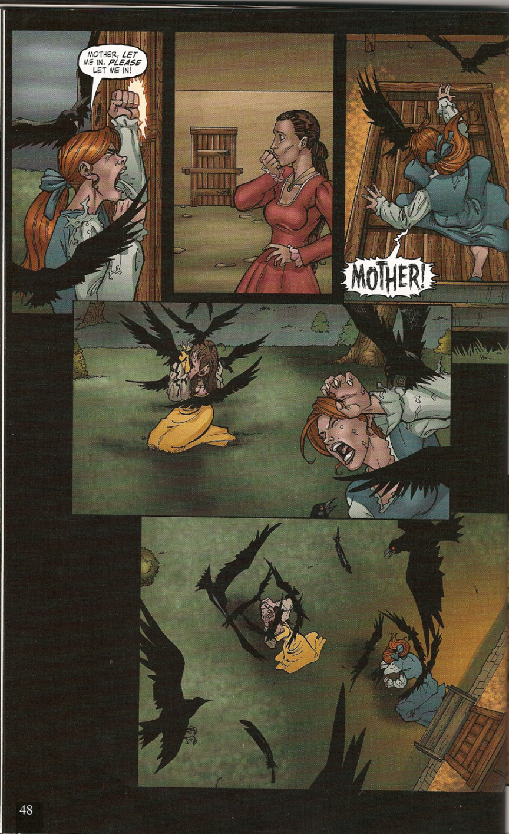
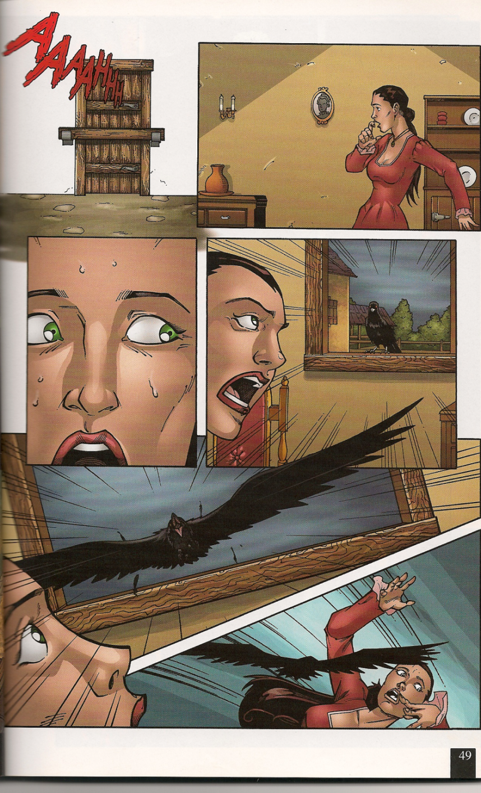
Cinderella
Ralph Tedesco – Joe Brusha
2005

Slide 14
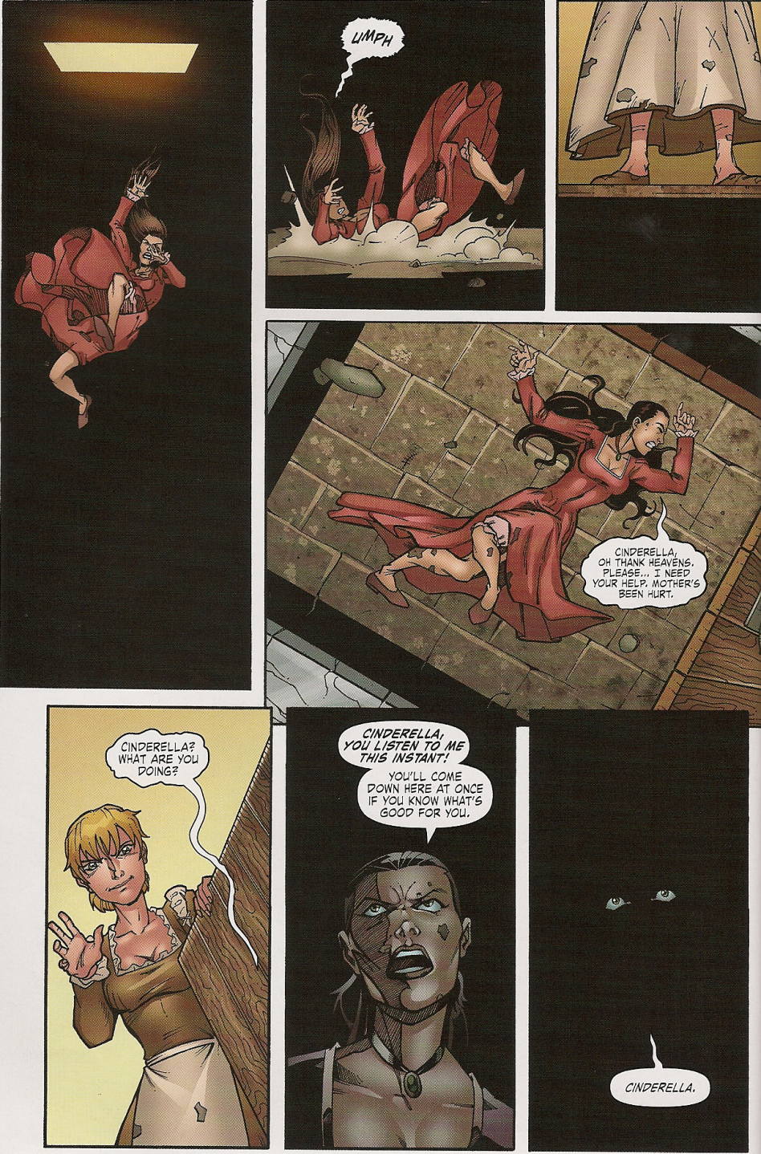
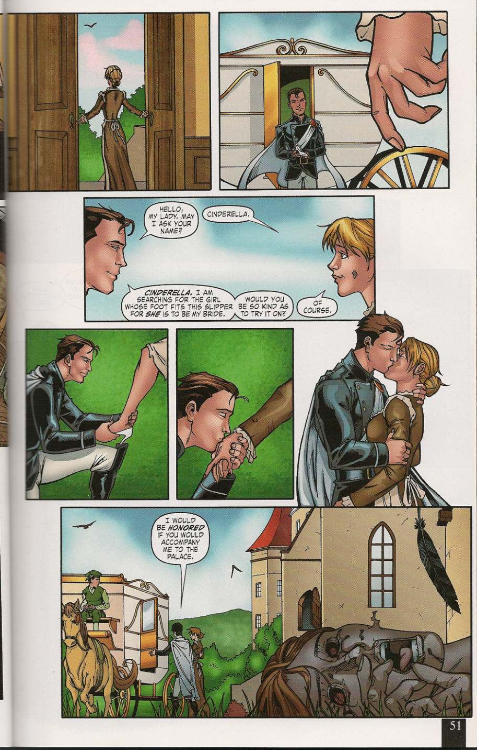
Cinderella
Ralph Tedesco – Joe Brusha
2005

Slide 15
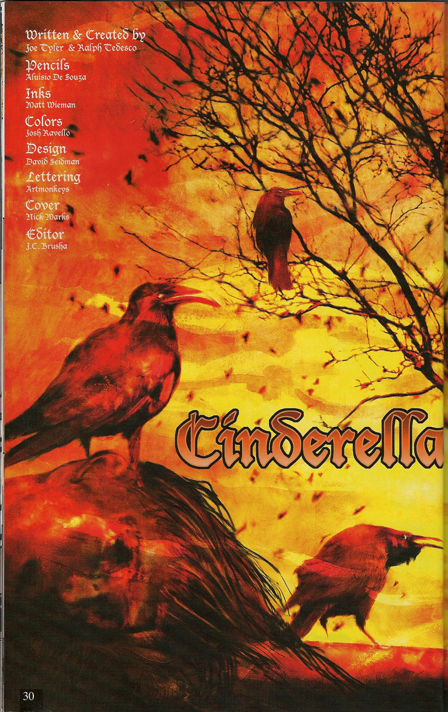
Cinderella
Ralph Tedesco – Aluisio De Souza
2005

Slide 16
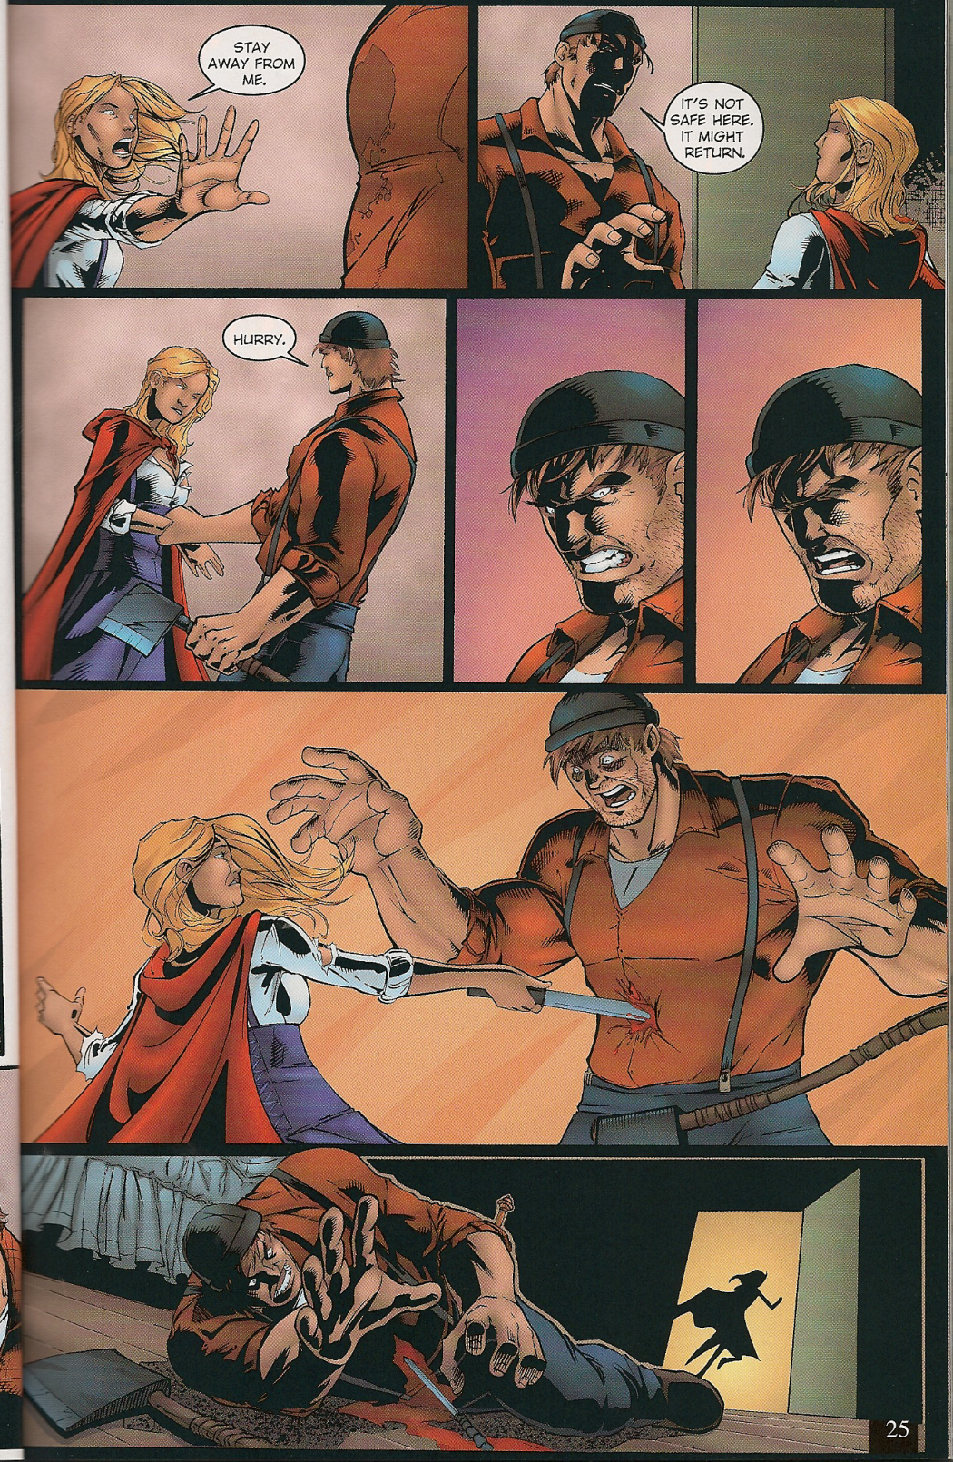
Little Red Riding Hood
Ralph Tedesco – Joe Brusha
2005

Slide 17
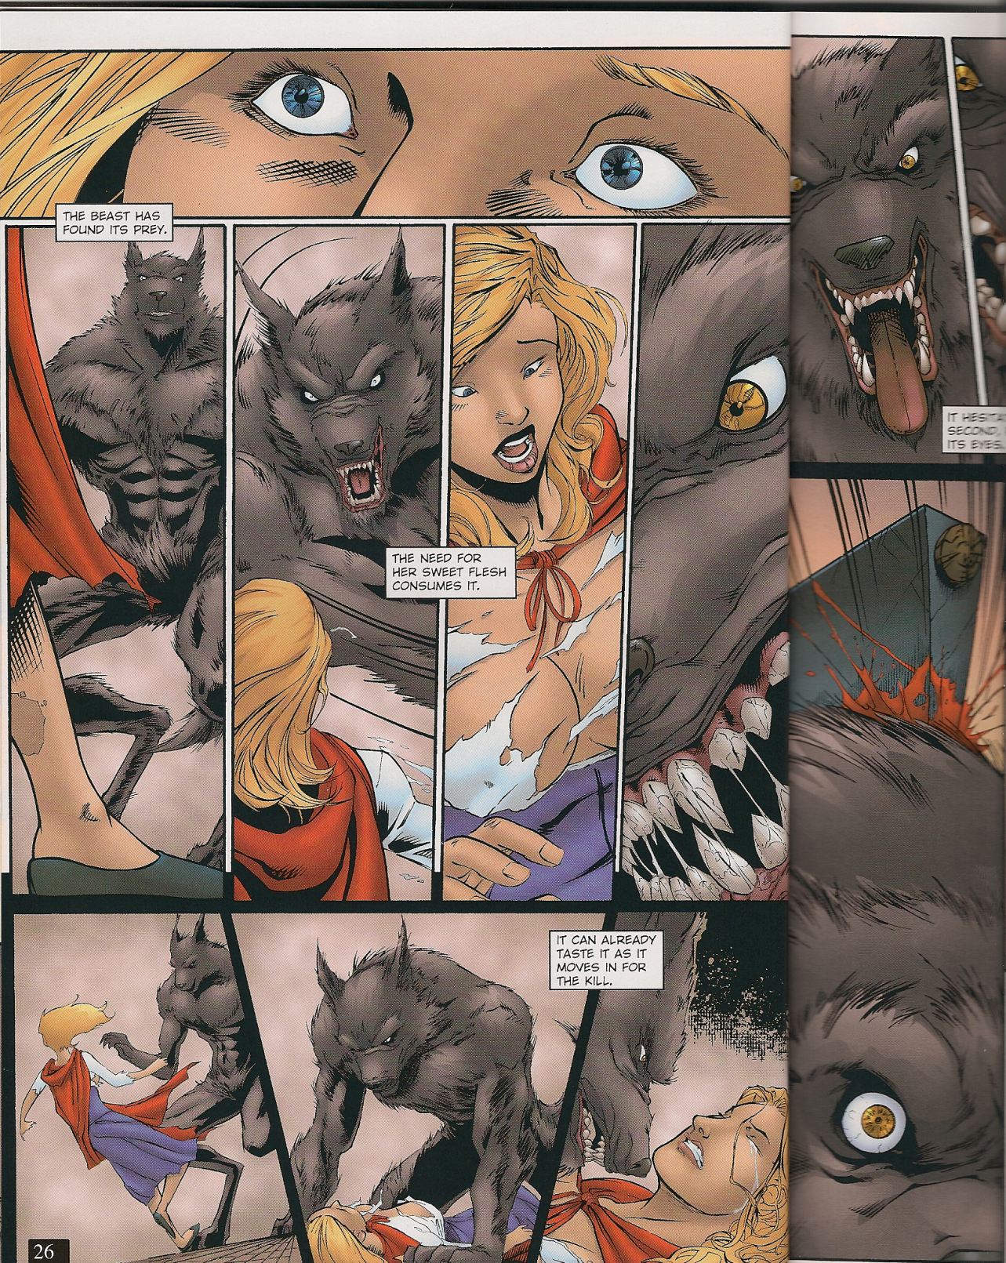
Little Red Riding Hood
Ralph Tedesco – Joe Brusha
2005

Slide 18
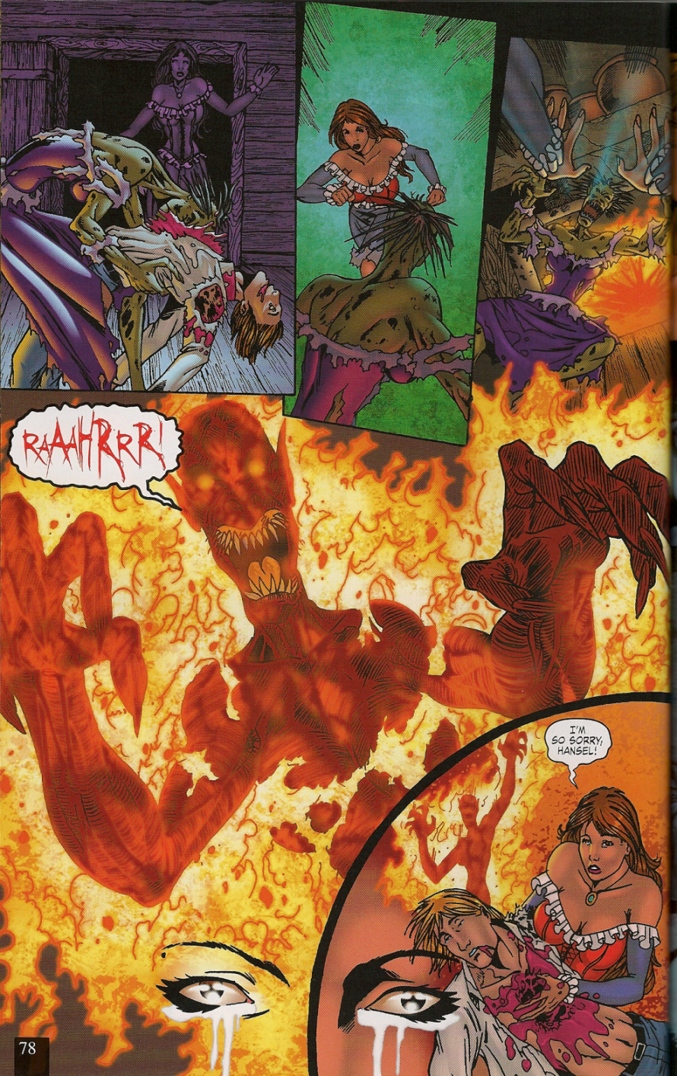
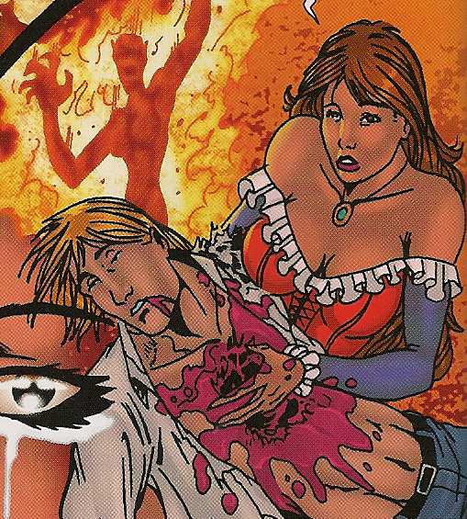
Hansel & Gretel
Ralph Tedesco – Joe Brusha
2005

Slide 19
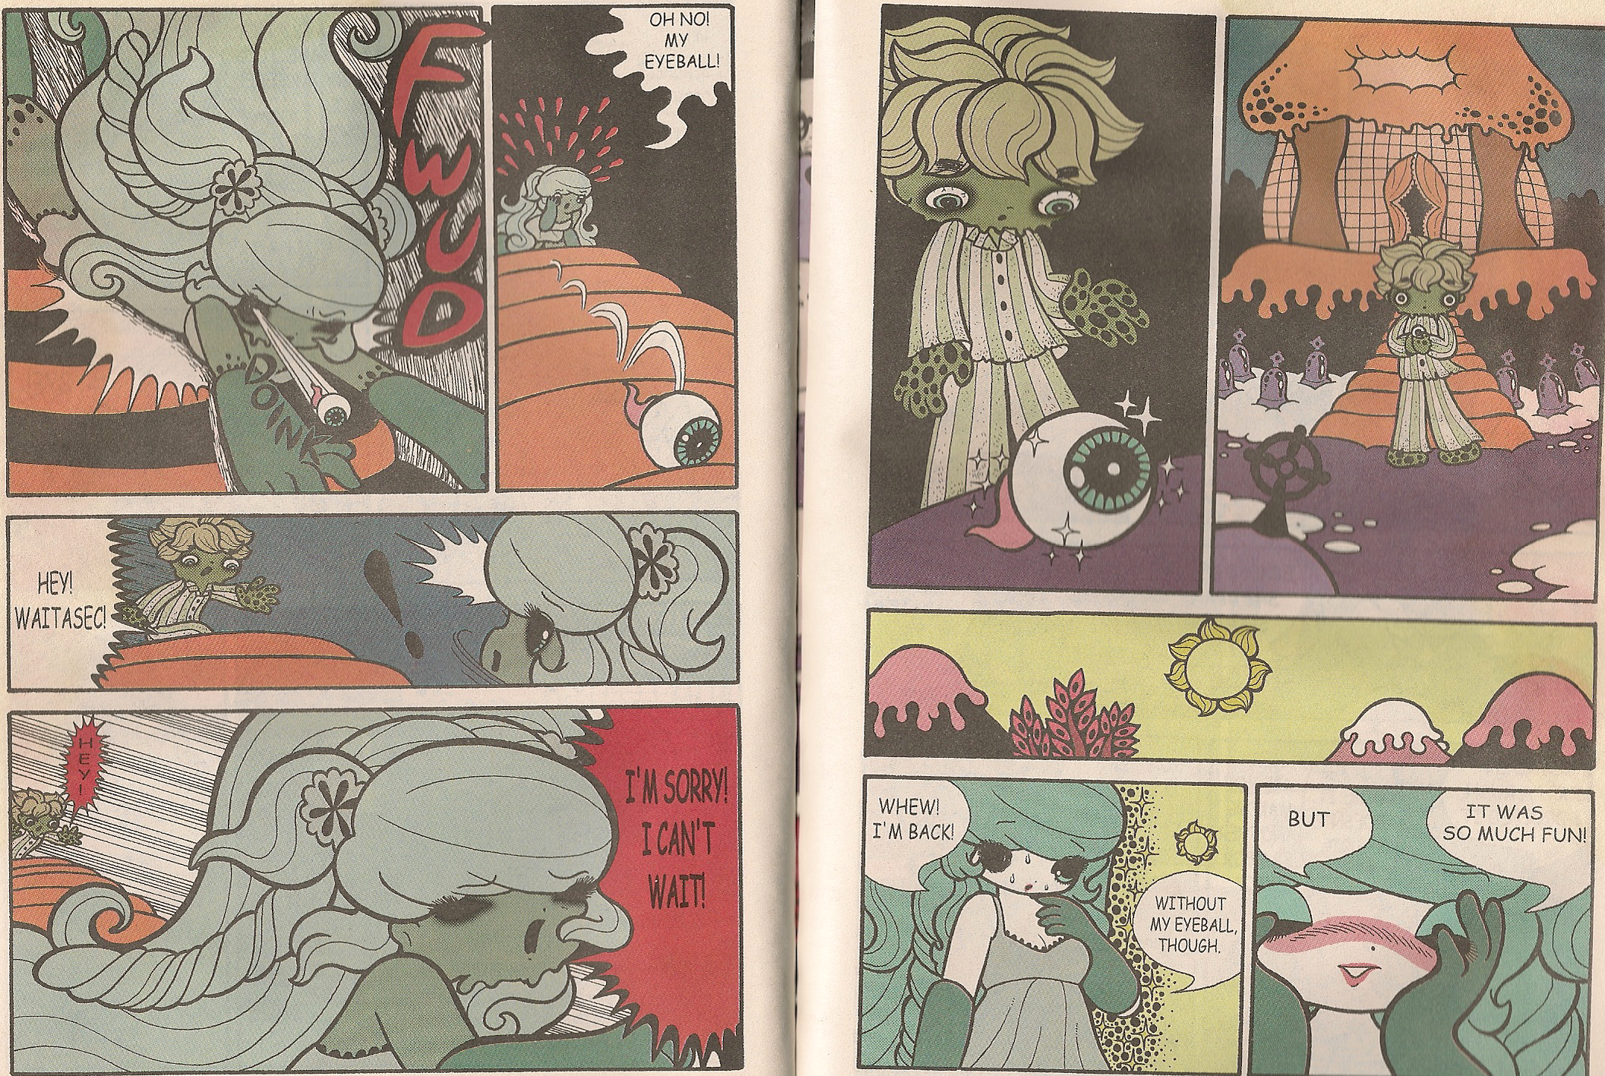
Cinderalla
Junko Mizuno
2002

Slide 20
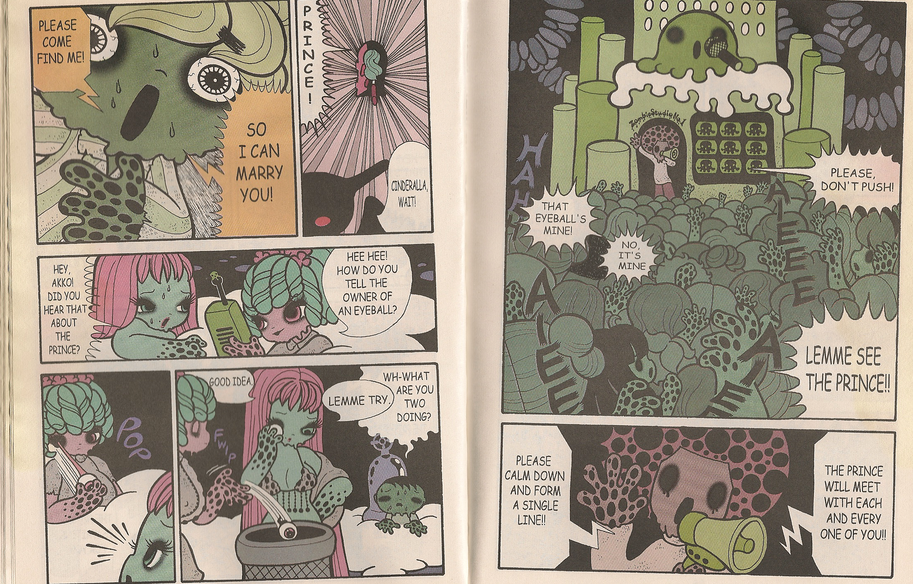
Cinderalla
Junko Mizuno
2002

Slide 21
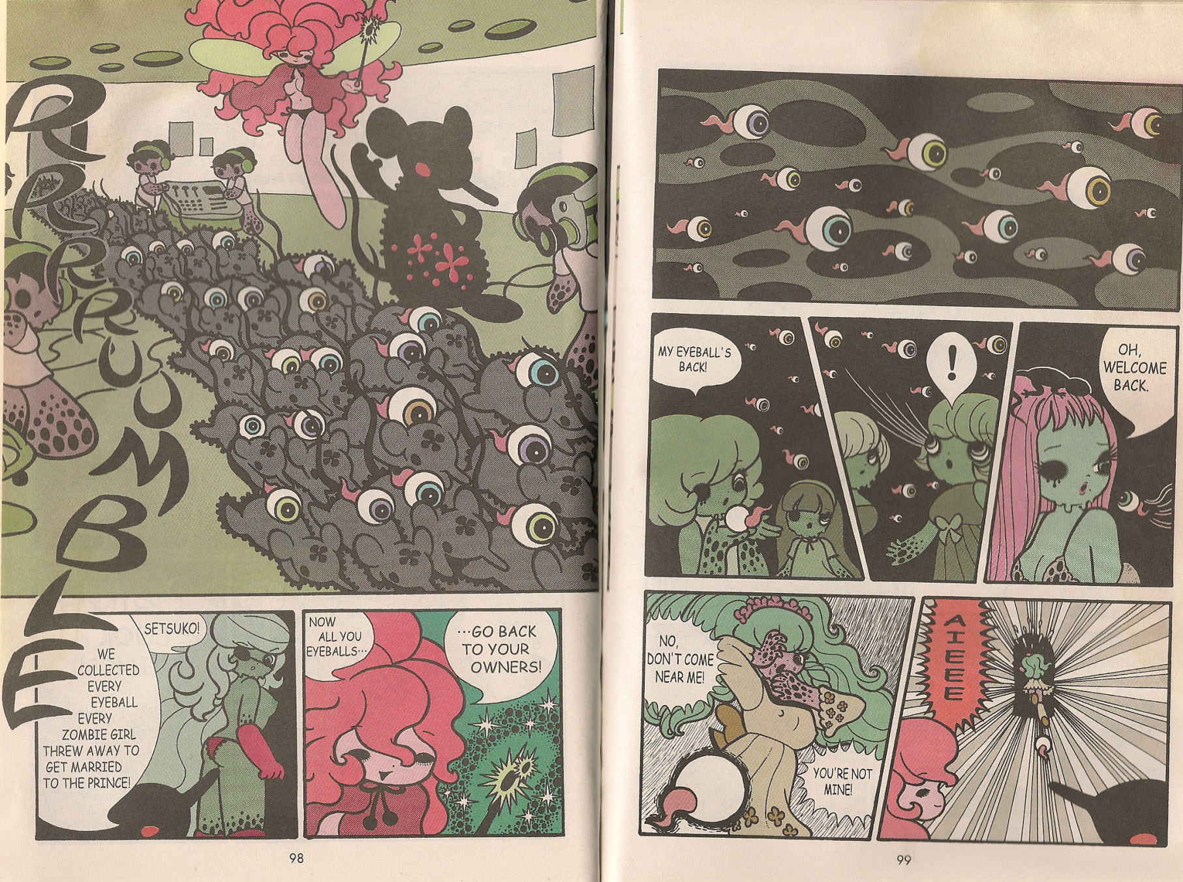
Cinderalla
Junko Mizuno
2002

Slide 22
Cinderella
Ralph Tedesco – Joe Brusha
2005

Slide 23
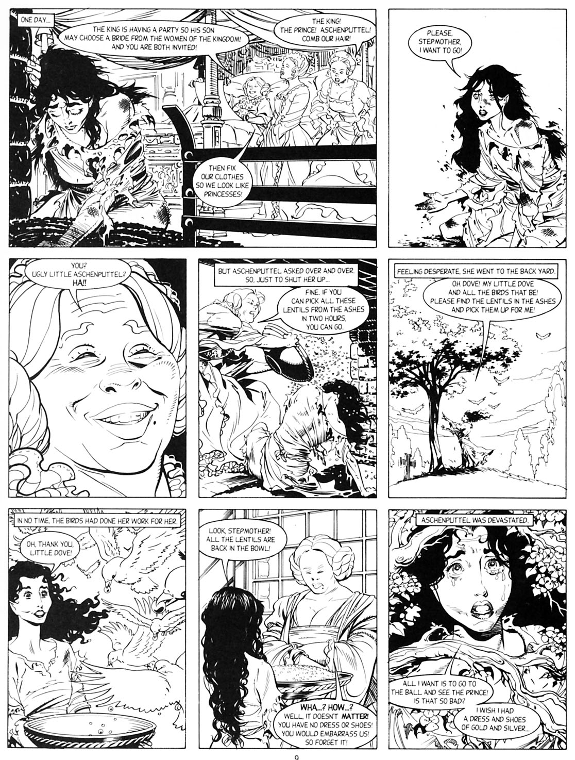
Aschenputtel or Cinderella
Jonathan Vankin – George Freeman
1990

Slide 24
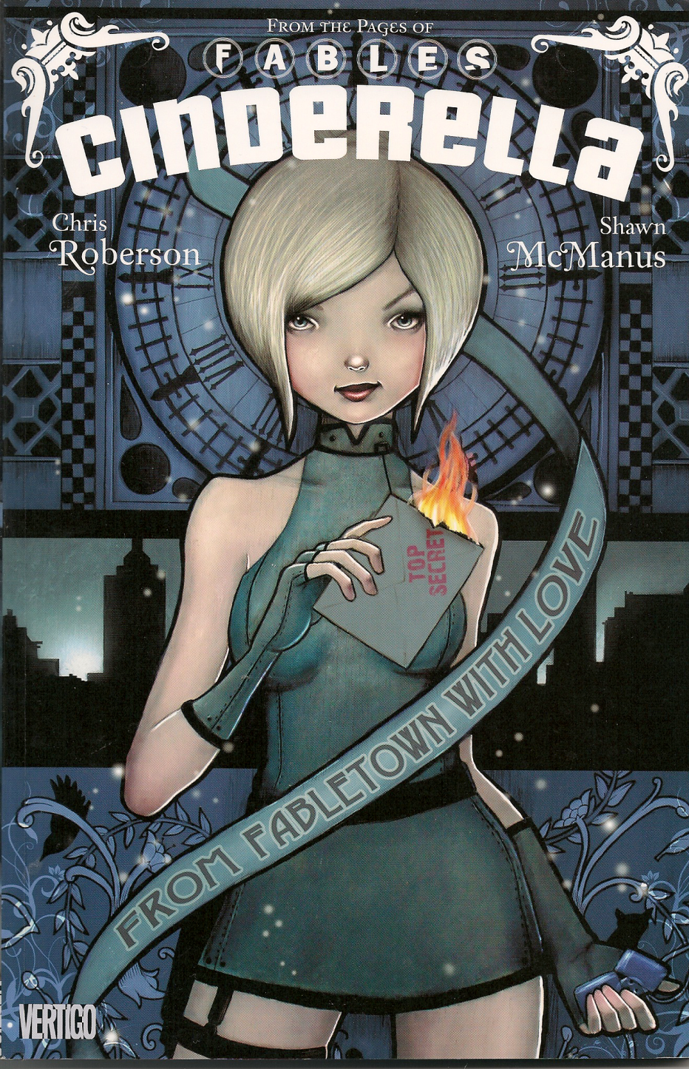
Cinderella
Chris Robertson – Shawn McManus
2010

Slide 25
Hansel & Gretel
Ralph Tedesco – Joe Brusha
2005

Slide 26
Hansel & Gretel
Junko Mizuno
2003

Slide 27
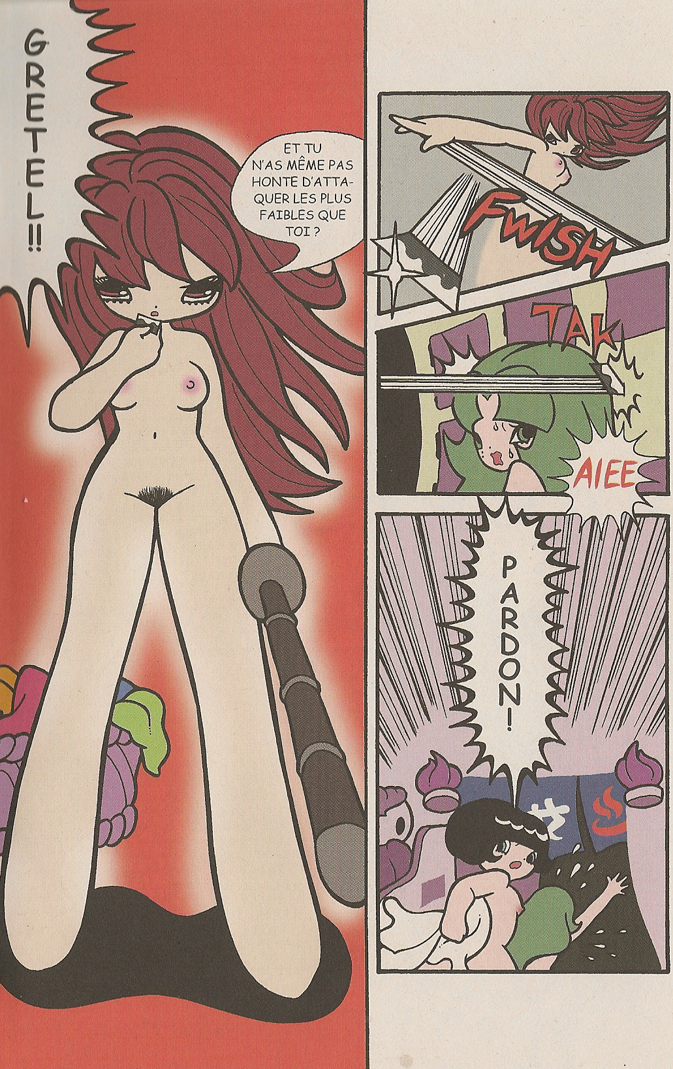
Hansel & Gretel
Junko Mizuno
2003

Slide 28
Cinderalla
Junko Mizuno
2002

Slide 29
Cinderalla
Junko Mizuno
2002

Slide 30
Cinderalla
Junko Mizuno
2002

Slide 31
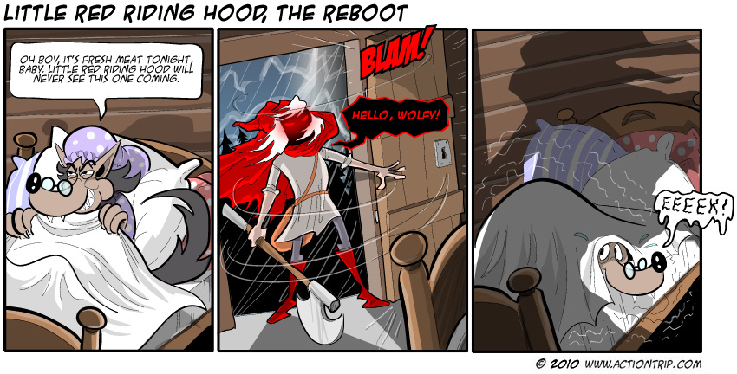
Little Red Riding Hood
2010

Slide 32
Όταν τα παραμύθια των αδελφών Grimm επιστρέφουν στους ενηλίκους η περίπτωση των κόμικς
Μαριάννα Μίσιου (Διδάκτωρ Πανεπιστημίου Αιγαίου)
Γιάννης Κουκουλάς (Υπ. Διδάκτωρ ΑΣΚΤ)

