Slide 1
5^{ο} ΜΑΘΗΜΑ Η ΑΝΑ – ΑΝΑΠΑΡΑΣΤΑΣΗ ΤΟΥ ΜΗ (;) ΑΝΑΠΑΡΑΣΤΑΣΙΜΟΥ
ΔΙ-ΕΙΚΟΝΙΚΟΤΗΤΑ ΣΤΗΝ ΕΙΚΟΝΟΓΡΑΦΗΜΕΝΗ ΑΦΗΓΗΣΗ
ΤΜΗΜΑ ΘΕΩΡΙΑΣ ΚΑΙ ΙΣΤΟΡΙΑΣ ΤΗΣ ΤΕΧΝΗΣ - ΑΣΚΤ
ΓΙΑΝΝΗΣ ΚΟΥΚΟΥΛΑΣ

Slide 3
Art Spiegelman, Maus,
1987

Slide 4
Art Spiegelman, Metamaus, 2011

Slide 5
Art Spiegelman, Maus,
1987

Slide 6
Art Spiegelman, Metamaus,
2011

Slide 7
Ιλάν Μανουάχ, Katz,
2010

Slide 8
Katz is a pirated edition of Art Spiegelman’s seminal graphic novel Maus. Katz is an exact copy of the French edition of Maus, with the difference that all the animal characters, have been redrawn as cats. The book was printed on November 2011 and it was seen in public for the first time in January 2012 during the International Comics Festival of Angoulême which ran under Spiegelman’s presidency. Two weeks before the book officially hit the book stores, the lawyers of Flammarion, the copyright holders of the French translation sent to the authors a cease-and-desist letter containing a five hundred page document containing comparison spreads from both Maus and Katz, interviews from Ilan Manouach, and his correspondence with Art Spiegelman. Refusing to take into account the conversational nature of the operation and its very limited printrun, Flammarion framed Katz as a counterfeit product and sought an injunction against the small Belgian press. The destruction of the totality of the print run took place in Brussels on March 15th 2012, in a specialised paper destruction facility.
288 pages | softcover edition 170mm x 240mm | 2011

Slide 9
Ιλάν Μανουάχ, Metakatz,
2010

Slide 10
Metakatz is a collective reader extending the questions raised by the book, Katz and its fatal destruction. Artists, critics, lawyers, social scientists, destruction facility specialists and anonymous blog users were invited to contribute their feedback and investigate other rip-off practices in comics, research the use of animal metaphors in storytelling or produce derivative works. This book gave birth to an ongoing research project Essaim, a web platform publisher that brings in tandem the potential of p2p and crowd-funding with the aim to produce authorless books that can be assumed on a collective nebular basis. The book comes with a seven inch vinyl that documents the industrial destruction of the book Katz.
210 pages | hardcover edition K 200mm x 230mm | 2010 |

Slide 11
Michel Kichka,
Δεύτερη Γενιά,
2012

Slide 12
Michel Kichka,
Δεύτερη Γενιά,
2012

Slide 13
Αντουάν ντε Σαιντ Εξυπερύ,
Ο Μικρός Πρίγκιπας,
1942

Slide 14
Michel Kichka,
Δεύτερη Γενιά,
2012

Slide 16
Michel Kichka, Δεύτερη Γενιά, 2012

Slide 17
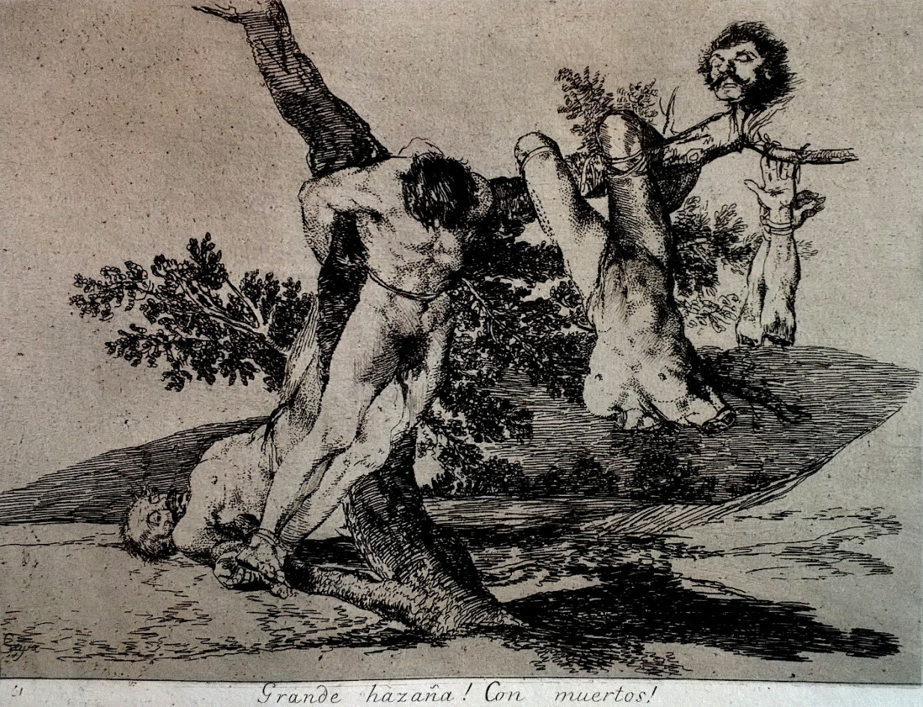
Francisco Goya, Οι Καταστροφές του Πολέμου, 1810 - 1820

Slide 19
Soloup, Αϊβαλί, 2014

Slide 20
Κώστας Γρηγοριάδης, 2018

Slide 21
Soloup, 2014

Slide 22
Alexsandro Palombo,
2015

Slide 23
Alexsandro Palombo,
2015

Slide 27
Αρκάς, Η Αποικία, 2018

Slide 28
Αρκάς, Η Αποικία, 2018

Slide 29
Αρκάς, Η Αποικία, 2018

Slide 30
Αρκάς, Η Αποικία, 2018

Slide 31
Αρκάς, Η Αποικία, 2018

Slide 32
Αρκάς, Η Αποικία, 2018

Slide 33
Γιώργος Μικάλεφ,
2018

Slide 34
Greg Pak,
Carmine di Giandomenico,
Matt Hollingsworth,
Marko Djurdjevic,
X-Men: Magneto Testament #4, 2008

Slide 35
Greg Pak,
Carmine di Giandomenico,
Matt Hollingsworth,
Marko Djurdjevic,
X-Men: Magneto Testament #4, 2008

Slide 36
Άρι Φόλμαν, Νταβίντ Πολόνσκυ, Το Ημερολόγιο της Άννας Φρανκ,
2018

Slide 37
Σιντ Γιάκομπσον,
Ερνί Κολόν,
Άννα Φρανκ, 2018

Slide 38
Άρι Φόλμαν, Νταβίντ Πολόνσκυ, Το Ημερολόγιο της Άννας Φρανκ,
2018

Slide 39
Άρι Φόλμαν, Νταβίντ Πολόνσκυ, Το Ημερολόγιο της Άννας Φρανκ,
2018

Slide 40
Henry Moore,
Tube Shelter Perspective,
1941

Slide 41
Henry Moore, Tube Shelter Perspective, 1941

Slide 42
Bill Brandt, 1940

Slide 43
Guido Crepax,
Art and Fashion,
2015

Slide 44
Henry Moore,
King and Queen,
1952

Slide 45
Guido Crepax,
Art and Fashion,
2015

Slide 46
Guido Crepax,
Art and Fashion,
2015

Slide 49
